Slide 1
Basic Computer Organization and Design
www.teachics.org
Computer Organization & Architecture - MODULE 3
PART 2

Slide 2
Instruction Cycle

Slide 3
Instruction Cycle
A program consists of a sequence of instructions is executed in the computer by going through a cycle for each instruction.
Each instruction cycle in turn is subdivided into a sequence of subcycles or phases
They are
Fetch an instruction from memory.
Decode the instruction.
Read the effective address from memory if the instruction has an indirect address.
Execute the instruction.
Upon the completion of step 4, the control goes back to step 1 to fetch, decode, and execute the next instruction.
This process continues indefinitely unless a HALT instruction is encountered.

Slide 4
Fetch & Decode
Initially, the program counter PC is loaded with the address of the first instruction in the program.
SC is cleared to 0, providing a decoded timing signal T0.
After each clock pulse, SC is incremented by one, so that the timing signals go through a sequence T0, T1, T2, and so on.
The microoperations for the fetch and decode phases are
T₀: AR ← PC
T₁: IR ← M [AR], PC ← PC+1
T₂: D0,. . . , D7 ← Decode IR(12–14), AR ← IR(0-11), I ← IR(15)

Slide 5
Fetch & Decode
During T₀ the address is transferred from PC to AR.
At T₁ The instruction read from memory is placed in the instruction register IR and PC is incremented by one to prepare it for the address of the next instruction.
At time T2, the op-code in IR is decoded, the indirect bit is transferred to flip-flop I, and the address part of the instruction is transferred to AR.
Note that SC is incremented after each clock pulse to produce the sequence T₀, T₁, and T₂.

Slide 6
Determine the Type of Instruction
During time T3, the control unit determines the type of instruction that was just read from memory.
Memory Reference Instructions
If D7=0, the op-code will be 000 through 110
If D7 =0 and I =1 - memory reference instruction with an indirect address.
The micro-operation for the indirect address condition can be symbolized by AR ← M [AR].
Register Reference or I/O Instructions
If D₇ =1 and I=0 - Register Reference Instruction.
If D₇ =1 and I=1 - I/O Instruction.

Slide 7
The three instruction types are subdivided into four separate paths.
The selected operation is activated with T₃.
D7’ IT₃ : AR ← M[AR].
D7’ IT₃ : Nothing.
D7 I’T₃ : Execute a register-reference instruction.
D7 IT₃ : Execute an input–output instruction.

Slide 8
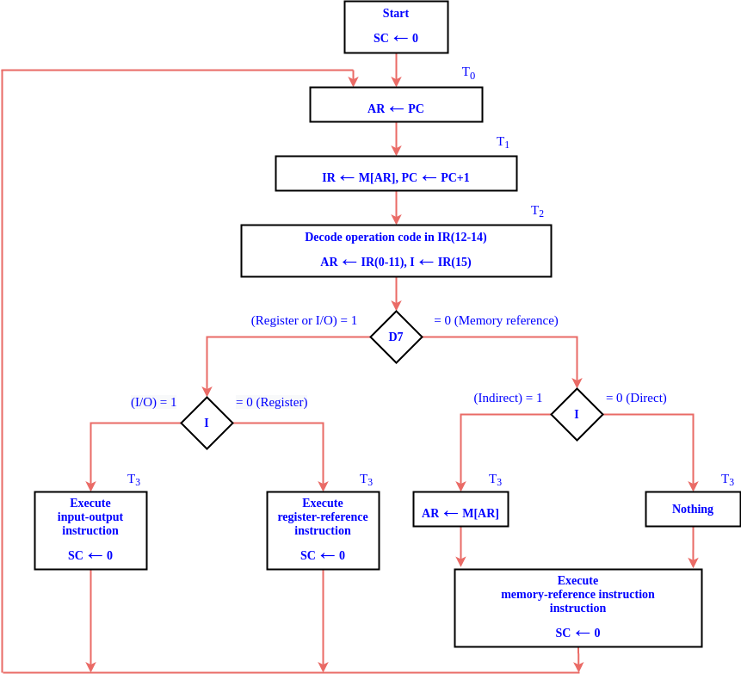

Slide 9
Memory Reference Instruction

Slide 10

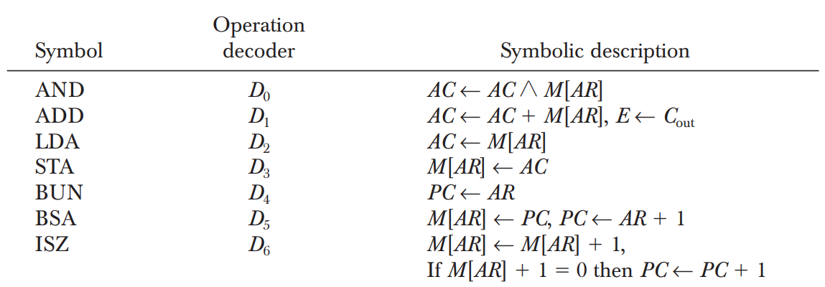
Memory Reference Instruction
Memory reference instructions performs operation with memory operand.
Execution of memory reference instruction starts with timing signal T₄.
There are 7 memory instruction.

Slide 11
AND to AC
ADD to AC
Performs AND logic operation on pairs of bits in AC and the memory word specified by effective address.
The result of operation is transferred to AC.
D₀T₄: DR ← M [AR] D₀T₅: AC ← AC ^ DR, SC ← 0
Adds the content of the memory word specified by the effective address to the value of AC.
Sum is transferred to AC and output carry C_{out} is transferred into E (Extended accumulator flipflop)
D₁T₄: DR ← M [AR] D₁T₅: AC ← AC ^ DR, E ← C_{out}, SC ← 0

Slide 12
LDA : Load to AC
STA : Store to AC
Transfers the memory word specified by the effective address to AC.
D₂T₄: DR ← M [AR] D₂T₅: AC ← DR, SC ← 0
Stores the content of AC into the memory word specified by the effective address.
D₃T₄: M [AR] ← AC, SC ← 0

Slide 13
ISZ: Increment and Skip if Zero
BUN : Branch Unconditionally
Increments the word specified by the effective address, and if the incremented value is equal to 0, PC is incremented by 1 in order to skip the next instruction in the program.
D₆T₄: DR ← M [AR] D₆T₅: DR ← DR+1 D₆T₆: M [AR] ← DR, if (DR 0) then (PC ← PC 1), SC ← 0
Transfers the program to the instruction specified by the effective address.
D₄T₄: PC ← AR, SC ← 0

Slide 14
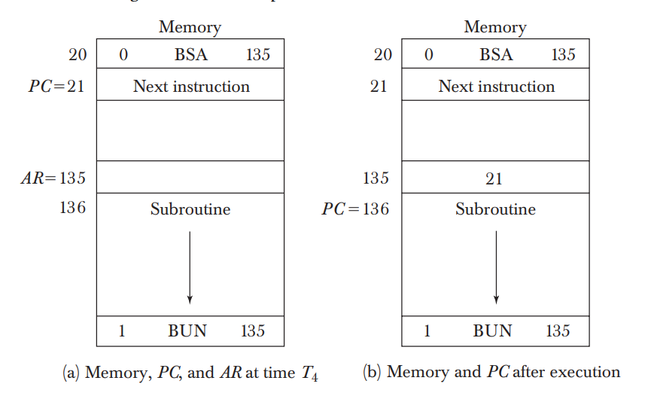
BSA : Branch and Save Return Address
Used for branching to a portion of the program called a subroutine or procedure.
It stores the address of the next instruction into a memory location specified by the effective address.
The effective address plus one is transferred to PC to serve as the address of the first instruction in the subroutine.
D₅T₄: M [AR] ← PC, AR ← AR + 1 D₅T₅: PC ← AR, SC ← 0

Slide 15
Register Reference Instructions

Slide 16
Register Reference Instructions
It specifies an operation on or test of the Accumulator.
An operand from memory is not needed.
They are recognized by the control when D₇ = 1 and I = 0.
Execution start with the timing signal T₃.
Each control function needs the Boolean relation D₇IT₃ and is represented by the symbol r.
By assigning the symbol B, to bit i of IR(0-11), all control functions can be simply denoted by rBi.

Slide 17
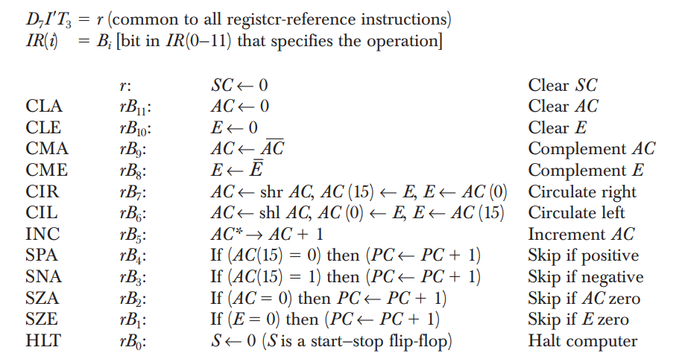

Slide 18
Input and Output Communication

Slide 19
Input-Output Instructions
Needed for
transferring information to and from AC register.
for checking the flag bits.
for controlling the interrupt facility.
Recognized by the control when D₇ =1 and I =1.
The remaining bits(0-11) of the instruction specify the particular operation.
Executed with the clock transition associated with timing signal T3.
Each control function needs a Boolean relation D₇IT₃, and is represented by the symbol p.
By assigning the symbol Bi to bit i of IR, all control functions can be denoted by pB_{i} for i = 6 through 11.

Slide 20
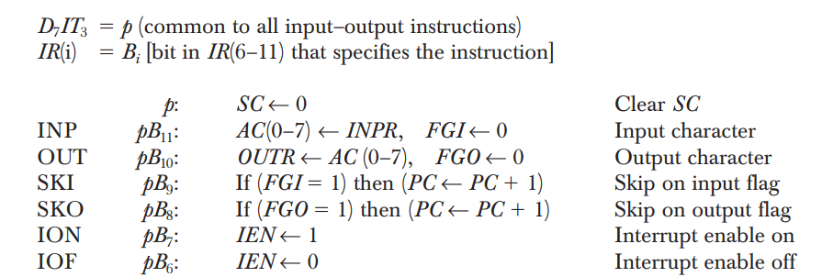
Input-Output Instructions

Slide 21
Program Interrupt

Slide 22
Need for Interrupt
In basic case (Programmed control transfer), the computer keeps checking the flag bit, and when it finds it set, it initiates an information transfer.
This type of transfer is inefficient because of the difference of information flow rate between the computer and that of the input–output device.
The computer is wasting time while checking the flag instead of doing some other useful processing task.

Slide 23
Program Interrupt
An alternative to the programmed controlled procedure is to let the external device inform the computer when it is ready for the transfer.
In the meantime the computer can be busy with other tasks.
This type of transfer uses the interrupt facility.
While the computer is running a program, it does not check the flags.
When a flag is set, the computer is interrupted from proceeding with the current program.
The computer stops what it is doing to take care of the input or output transfer.
It then returns to the current program to continue what it was doing before the interrupt

Slide 24
Program Interrupt
The interrupt facility can be enabled or disabled by a flip-flop IEN.
The interrupt enable flip-flop IEN can be set and cleared with two instructions (IOF, ION).
When IEN is cleared to 0 (with the IOF instruction), the flags cannot interrupt the computer.
When IEN is set to 1 (with the ION instruction), the computer can be interrupted.
An interrupt flip-flop R is included in the computer to decide when to go through the interrupt cycle.
So the computer is either in an instruction cycle or in an interrupt cycle.

Slide 25
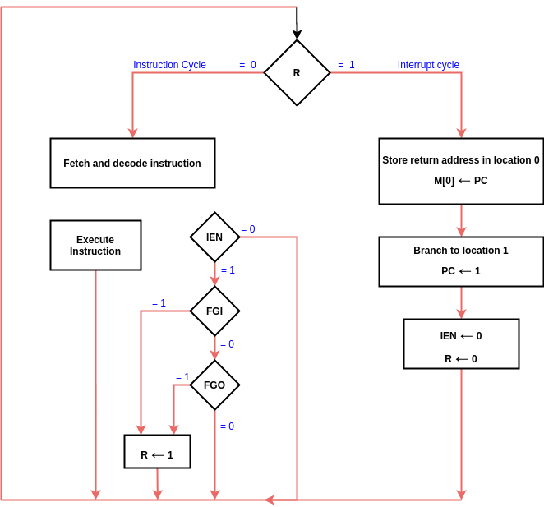
Interrupt Cycle
When R = 0, the computer goes through an instruction cycle.
During the execute phase IEN is checked. If it is 0, control continues with the next instruction cycle.
If IEN = 1, control checks the flag bits. If both flags are 0, control continues with the next instruction cycle.
If either flag is set to 1 while IEN = 1, R is set to 1 and control goes to an interrupt cycle.

Slide 26
Interrupt Cycle
The interrupt cycle is a hardware implementation of a branch and save return address operation.
The return address in PC is stored in a specific location. (Here address 0)
Control then inserts address 1 into PC and clears IEN and R so that no more interruptions can occur until the interrupt request serviced and flag has been set.
Micro-operations
RT₀: AR ← 0, TR ← PC
RT₁: M [AR] ← TR, PC ← 0
RT₂: PC ← PC 1, IEN ← 0, R ← 0, SC ← 0

Slide 27
Design of Basic Computer

Slide 28
Design of Basic Computer
The basic computer consists of the following hardware components:
A memory unit with 4096 words of 16 bits each.
Nine registers: AR, PC, DR, AC, IR, TR, OUTR, INPR, and SC.
Seven flip-flops: I, S, E, R, IEN, FGI, and FGO.
Two decoders: a 3x8 operation decoder and a 4x16 timing decoder.
A 16-bit common bus.
Control logic gates.
Adder and logic circuit connected to the input of AC.

Slide 29
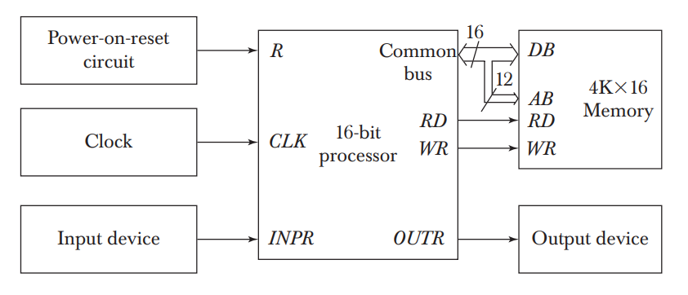
Design of Basic Computer

Slide 30
Control Logic Gates
The inputs to this circuit come from
two decoders
I flip-flop
bits 0 through 11 of IR.
The other inputs to the control logic are
AC bits 0 through 15 to check if AC =0 and to detect the sign bit in AC(15)
DR bits 0 through 15 to check if DR= 0
The values of the seven flip-flops.
The outputs of the control logic circuit are
Signals to control the inputs of the nine registers
Signals to control the read and write inputs of memory
Signals to set, clear, or complement the flip-flops
Signals for S₂, S₁, and S₀ to select a register for the bus
Signals to control the AC adder and logic circuit

Slide 31
Control of Registers and Memory
The control inputs of the registers are LD (load), INR (increment), and CLR (clear).
Eg: To derive the gate structure associated with the control inputs of AR. Find all the statements that change the content of AR R’T₀: AR ← PC R’T₂: AR ← IR(0–11) D₇’IT3: AR ← M [AR] RT₀: AR ← 0 D₅T₄: AR ← AR + 1
The control functions can be combined into three Boolean expressions as follows LD(AR) = R’T₀ + R’T₂ + D₇’IT₃ CLR(AR) = RT₀ INR(AR) = D₅T₄

Slide 32
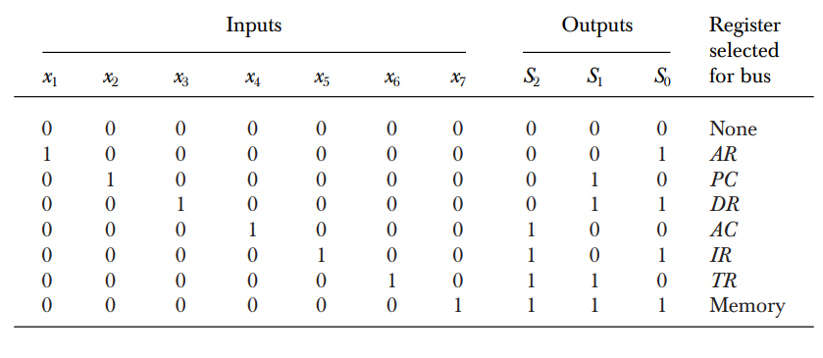
Control of Common Bus
The 16-bit common bus is controlled by the selection inputs S₂, S₁, and S₀.
The decimal number shown with each bus input specifies the equivalent binary number that must be applied to the selection inputs in order to select the corresponding register.
For example, when x₁ = 1, the value of S₂S₁S₀ must be 001 and the output of AR will be selected for the bus.

Slide 33
Control of Common Bus
The Boolean functions for the encoder are S₀ = x₁ + x₃ + x₅ + x₇ S₁ = x₂ + x₃ + x₆ + x₇ S₂ = x₄ + x₅ + x₆ + x₇
To determine the logic for each encoder input, it is necessary to find the control functions that place the corresponding register onto the bus.
For example, to find the logic that makes x₁ = 1, we scan all register transfer statements in and extract those statements that have AR as a source. D₄T₄: PC ← AR D₅T₅: PC ← AR Therefore, the Boolean function for x₁ is, x₁ = D₄T₄ D₅T₅
In a similar manner we can determine the gate logic for the other registers.

Slide 34
Design of Accumulator Logic

Slide 35
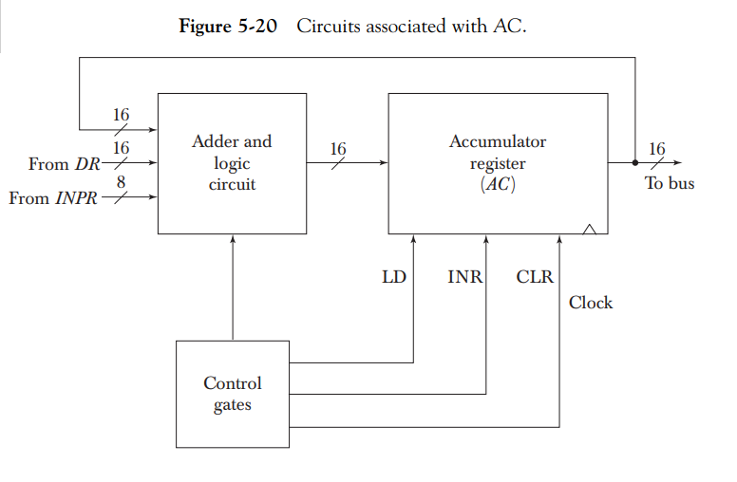
Design of Accumulator Logic
The adder and logic circuit has three sets of inputs.
16 inputs comes from the outputs of AC.
16 inputs comes from the data register DR.
eight inputs comes from the input register INPR.
The outputs of the adder and logic circuit provide the data inputs for the register.

Slide 36
Design of Accumulator Logic
In order to design the logic associated with AC, extract all the statements that change the content of AC. D₀T₅: AC ← AC ^ DR D₁T₅: AC ← AC + DR D₂T₅: AC ← DR pB₁₁: AC(07) ← INPR rB₉: AC ← AC rB₇: AC ← shr AC, AC(15) ← E rB₆: AC ← shl AC, AC(0) ← E rB₁₁: AC ← 0 rB₅: AC ← AC + 1
From this list we can derive the control logic gates and the adder and Logic circuit.

